Slide 1
Student Academic Performance and Influencing Factors Dataset
It is a student dataset that contains academic and personal information about students, including their socioeconomic scores, hours of study and sleep, attendance in percentage, and grades. It finds its application in analyzing those variables relating to academic performance. The socioeconomic score varies within the range of 0 to 1; the study hours, sleep hours, and attendance are continuous variables; and the grades are also constant, within the range of 0 to 100. This data probably tries to explore the way those elements impact student success.
Dataset Link: Predict Student Performance

Slide 2
Description of Data set
Field | Description | Range/Values | Relevance
Socioeconomic Score | A numerical value indicating the socioeconomic status of the student. | Values between 0 and 1. For example, 0.95822, 0.85566 | The variable provides insight into students' academic performance in relation to different economic backgrounds. It may point out something related to resource availability.
Study Hours | The number of hours the student dedicates to studying each day. | Real numbers, typically between 1 and 10. For example, 3.4, 7.9 | This feature tells us how much time a student puts in studying and is likely to be related with higher academic performance.

Slide 3
Field | Description | Range/Values | Relevance
Sleep Hours | The number of hours a student sleeps each day. | Real numbers, typically between 4 and 10 hours. For example, 8.2, 7.3 | Sleep is crucial for memory consolidation and cognitive function, both of which influence academic outcomes.
Attendance (%) | The percentage of classes the student attends. | Values between 0% and 100%. For example, 47%, 80% | Attendance can be a strong indicator of a student’s engagement and commitment to their education, which often affects grades.
Grades | The final academic grade or performance score achieved by the student. | Scores between 0 and 100. For example, 47, 35, 64 | Grades are the target variable in this dataset, representing student performance, which is influenced by study hours, sleep, attendance, and socioeconomic status.

Slide 4
More Information
Socioeconomic Score: This is likely to reflect the social and economic background of the student. It may include family income, level of education, and access to resources, all known to affect educational outcomes.
Study Hours: The amount of time a student spends studying out of the classroom. This is a continuous variable as each day a student can study more or less time, which might have a huge difference in grades.
Sleep Hours: This field represents how many hours a student sleeps every day. Though research indicates that insomnia disrupts cognitive function, focus, and therefore academic performance, students for some reason ignore their night sleep.
Attendance (%): Regular class attendance is usually considered vital in academic pursuits. This percentage would indicate how often the student attends classes, and generally, higher attendance correlates with higher academic success due to exposure to course material.
Grades: This is the target output. It gives the student's overall performance. Academic grades may be influenced by study habits, sleep, and attendance, among other factors that the dataset analyzes.

Slide 5
Dataset Entry
Socioeconomic Score | Study Hours | Sleep Hours | Attendance (%) | Grades
0.95822 | 3.4 | 8.2 | 53 | 47
0.85566 | 3.2 | 5.9 | 55 | 35
0.68025 | 3.2 | 9.3 | 41 | 32

Slide 6
MLS Well Defined Problem
The problem will be to predict Grades, referring to academic performance by a student, based on variables such as Socioeconomic Score, Study Hours, Sleep Hours, and Attendance. This is a regression problem since the objective will be to develop a model that predicts continuous values representing grades, ranging from 0 to 100. The independent variables are continuous in nature, and some preprocessing steps may be necessary, such as normalization, to ensure that the model works optimally.
This involves choosing an appropriate machine learning algorithm such as Linear Regression, Random Forest, and Gradient Boosting, for which to train the model. Such models are supposed to be tested based on certain performance metrics: Mean Squared Error, and R-squared. It allows understanding of the associations between the predictors; hence, an intervention or specific support given to the student may provide clues to how this impacts academic success.

Slide 7
Data collection
Socioeconomic Score
Study Hours
Sleep Hours
Attendance (%)
Grades
Data Preprocessing
Handle Missing Data Normalize/Scale
Split Data into Training and Test
Start
Predictions
Predict Grades for new data
Model Training
Train using Study Hours, Sleep Hours,
Socioeconomic Score, Attendance (%)
Model Selection
Linear Regression
Random Forest
Gradient Boosting
Stop

Slide 8
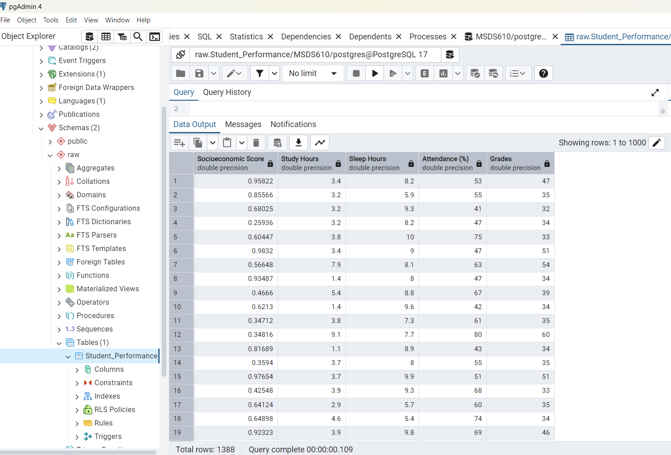
Picture of loaded data within pgAdmin

